Slide 1
Save the date for the 28th World Muscle Society Congress in Charleston, South Carolina, USA.

Slide 2
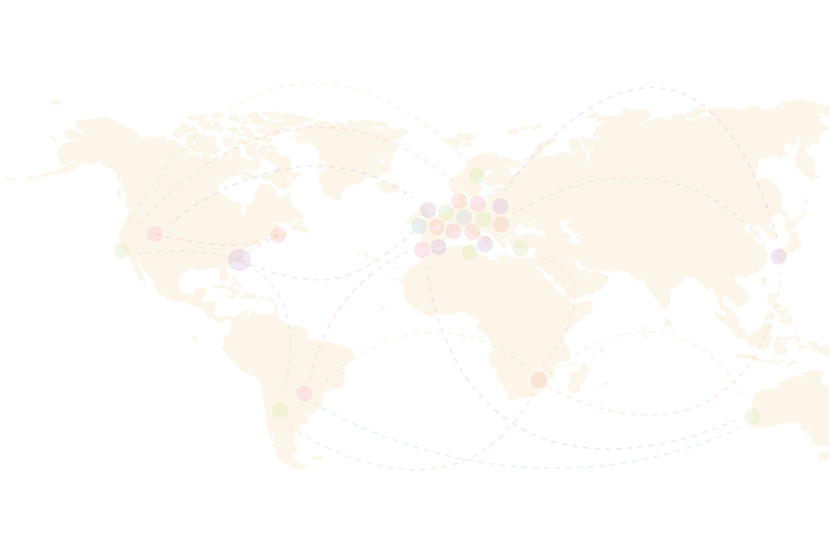
See you in
Charleston

Slide 3
Presentation Title
Full name, affiliation
Notes:
Presentation title slide

Slide 4
Disclosure
I have no actual or potential conflict of interest in relation to this presentation.
I have the following conflict/s of interest to declare:
###
##
Notes:
Disclosure Slide Template for Presentations at the WMS 2023 Congress. Delete and complete as relevant.
NOTE: This should be the first slide after the title slide

Slide 5
Notes:
Presentation content slide template – OPTION 1
you can choose to use this format template for the rest of your presentation but this is not mandatory

Slide 6
Notes:
Presentation content slide template – OPTION 2
you can choose to use this format template for the rest of your presentation but this is not mandatory

